Slide 1
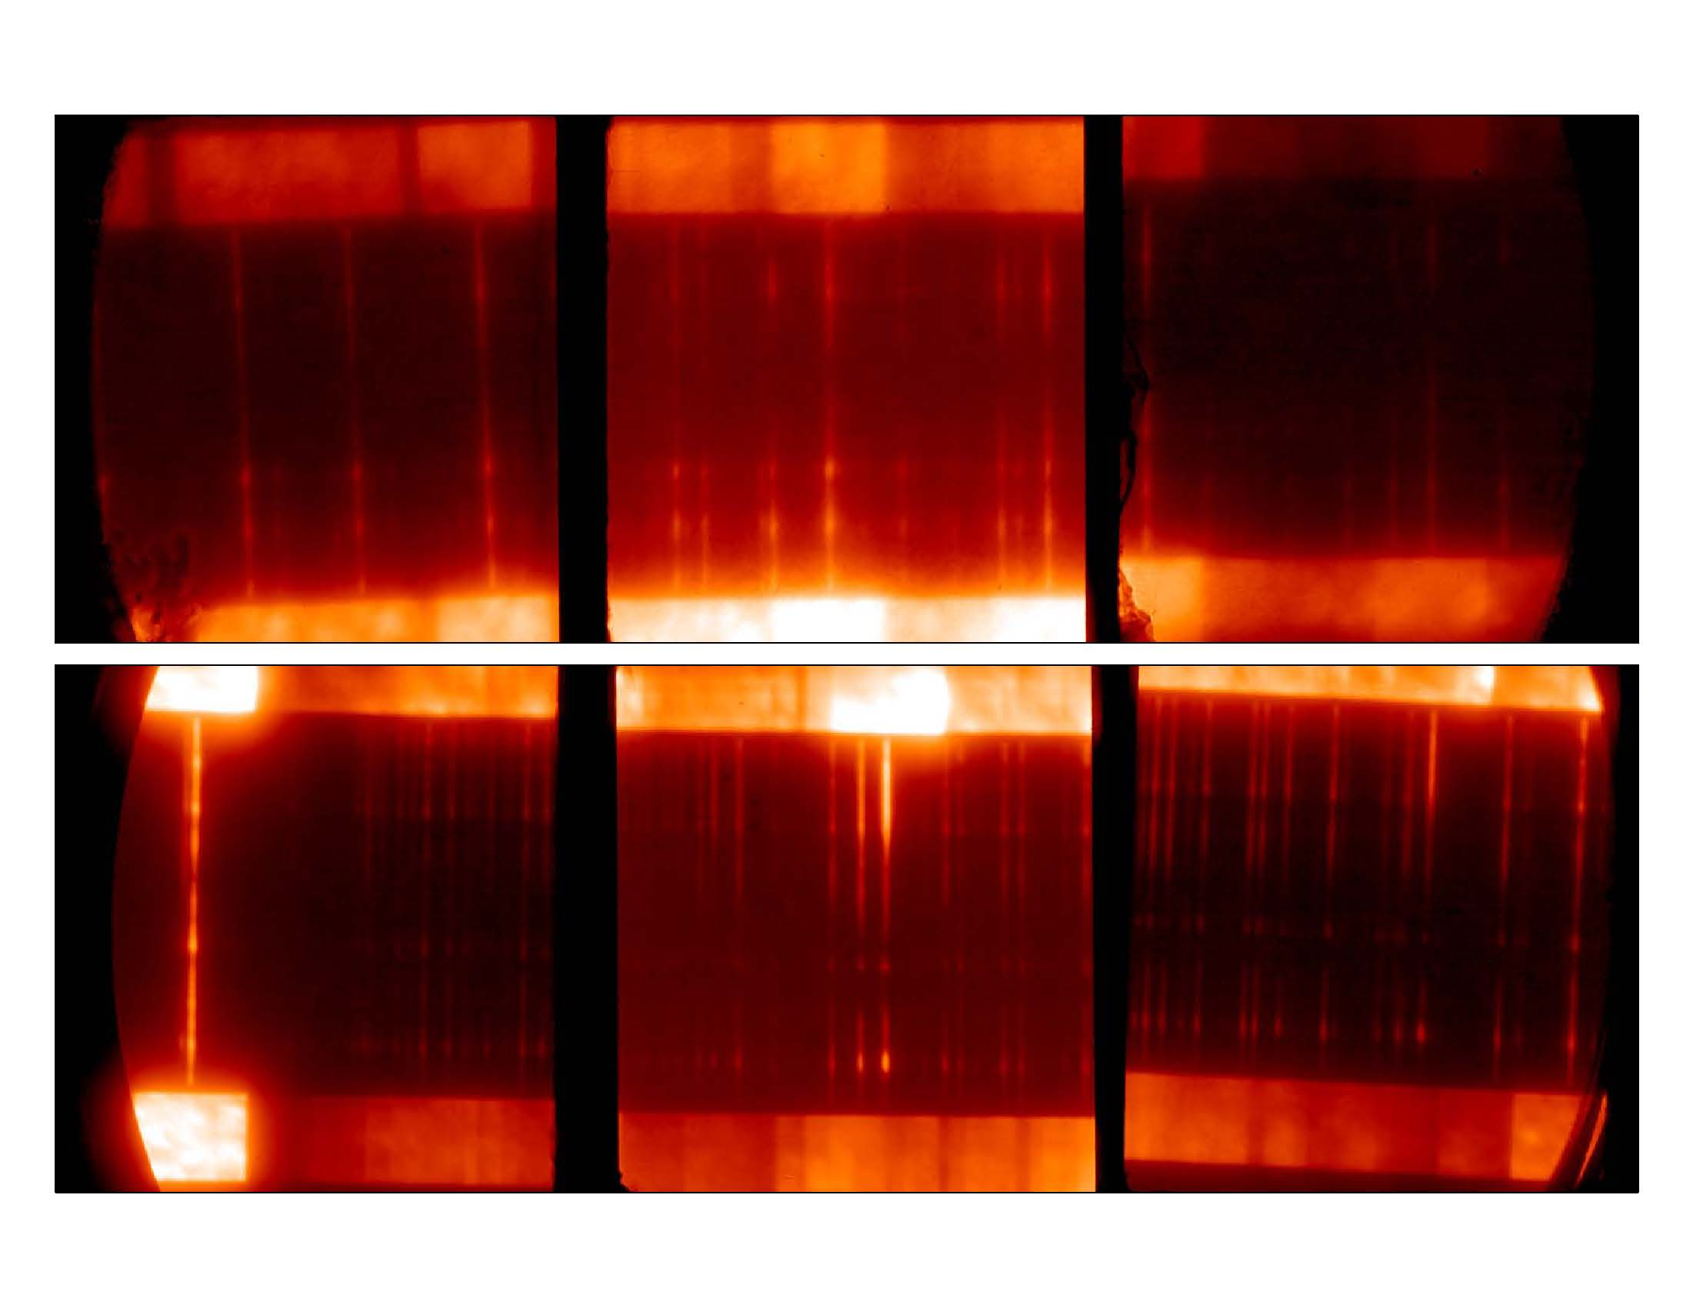
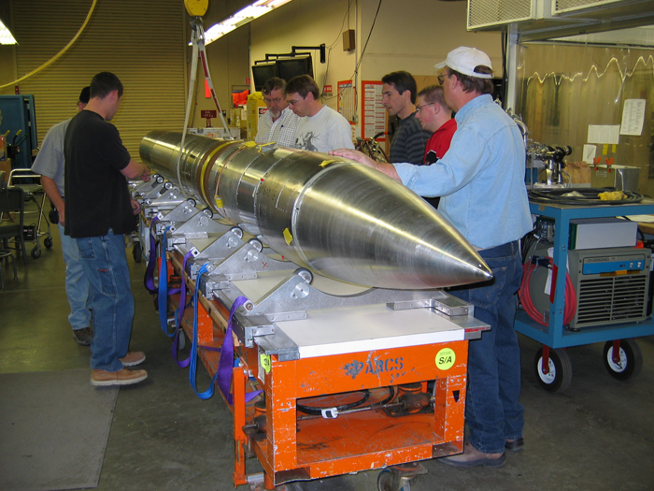
Extreme Ultraviolet Normal-Incidence Spectrograph (EUNIS)
Richard Schaefer

Slide 2
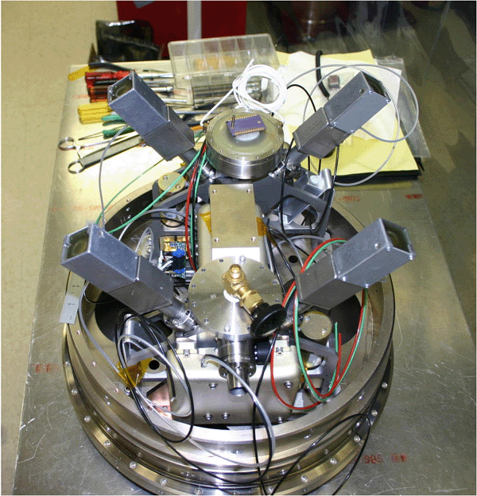
What is EUNIS?
EUNIS, the Extreme Ultraviolet Normal Incidence Spectrograph, is a sensitive, two-channel spectrograph that measures ultraviolet emission from the solar corona on board a sounding rocket.

Slide 3
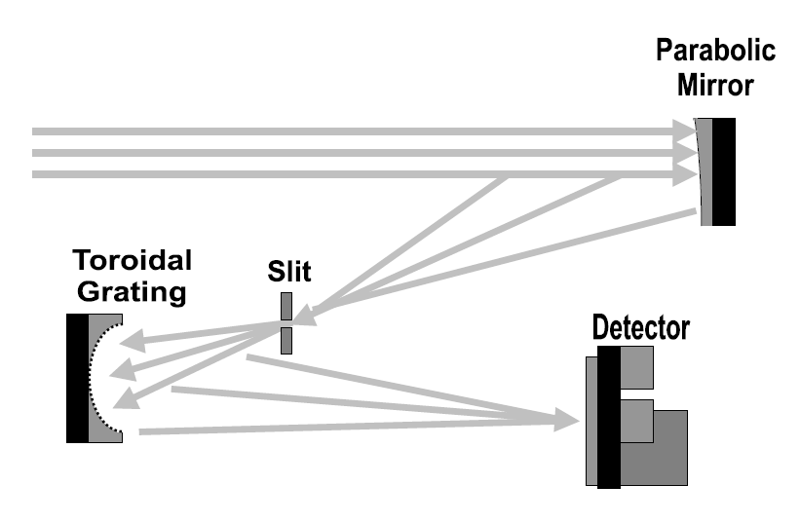
The Instrument
Notes:
Go through this faster

Slide 4
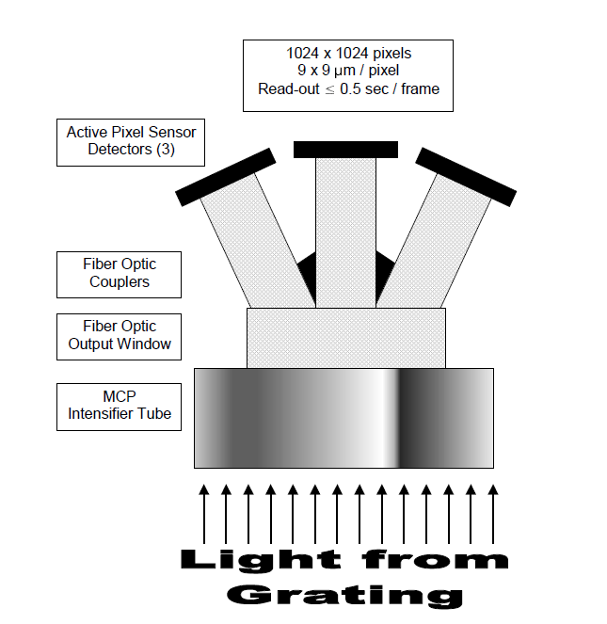
Quick Stats
Two channels
  170-205 Å
  300-370 Å
110 mm diameter telescope
3600 grooves/mm grating
~2 second cadence
Spectral resolution up to 35 mÅ
Most sensitive solar EUV spectrograph
Notes:
Don't read off the stats

Slide 5
EUNIS Objectives
To probe the structure and dynamics of the inner solar corona
To obtain spectra with a cadence as short as 2 sec, allowing unprecedented studies of the physical properties of evolving and transient structures.
To study diagnostics of wave heating and reconnection at heights above 2 solar radii, in the wind acceleration region.
To help recalibrate several orbital instruments, including SOHO/CDS and EIT,TRACE, Solar-B/EIS, SDO, and STEREO/EUVI.
  “Dumbbell” slits
Notes:
Don't read word for word, summarize quickly

Slide 6
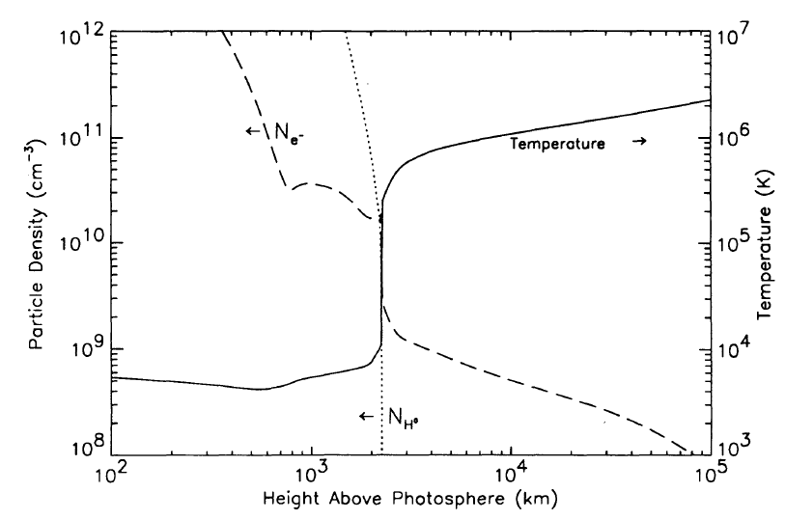
The Coronal Heating Problem
Rapid rise from ~10^4 K to ~10^6 K
Magnetic reconnection vs. wave heating
Nanoflares?
Courtesy Adrian Daw
Notes:
The main point is that the temperature of the solar atmosphere increases as you move away from the surface. Not something you expect from equilibrium thermodynamics. Not how heat conducts, we know this from the second law of thermodynamics.
The diagram is what you would expect from old models

Slide 7

What are spectra?
Separation of light into distinct frequencies or wavelengths.
Signature of an atomic transition
Early evidence for quantum mechanics
E = hf = hc/λ
Notes:
Talk about how the many things we are able to discern from the spectra:
- chemical composition
- temperature
- density
- motions, translational and rotational
- magnetic fields

Slide 8

The Data
Notes:
Note this is one particular exposure from about 250
Explain horizontal and vertical axes

Slide 9
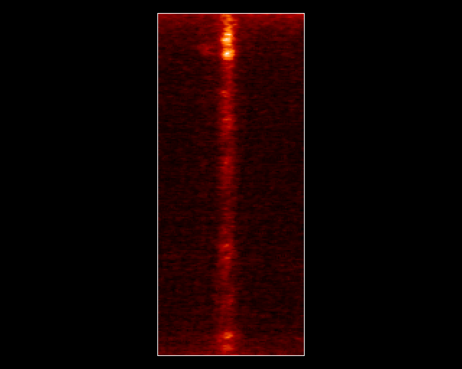
The Data
MgIX at 368 Ångstroms: A magnesium atom with 8 electrons stripped away. Forms at high temperatures.
Notes:
Mention how MgIX is an atom with 8 electrons stripped
Mention how we know the temperature by the ion which is formed.
Note the odd convention that astronomers use.

Slide 10
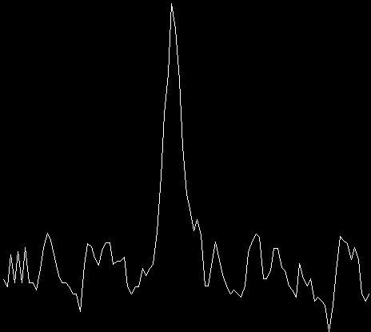
The Data
Notes:
Point out how the graph actually corresponds to the spectrum

Slide 11
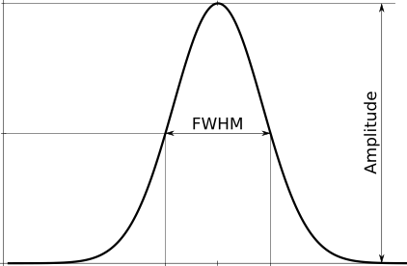
The Data
Able to calculate properties of the “stuff” we're looking at, such as
Intensity = 1.064 * (Amplitude) * (FWHM)
Velocity = (Δλ/λ)*c
Courtesy hlabsoft.com
Notes:
Explain what intensity and velocity actually are

Slide 12
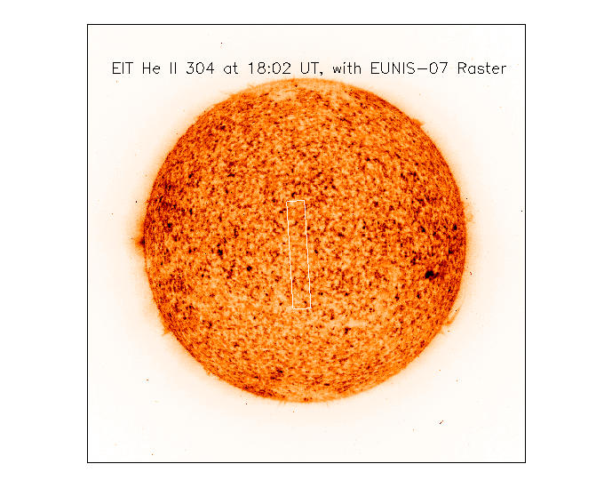
Raster Images
Courtesy Jeff Brosius

Slide 13
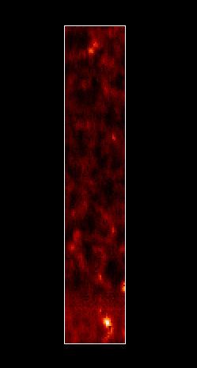
Raster Images
Notes:
Explain program in general here

Slide 14
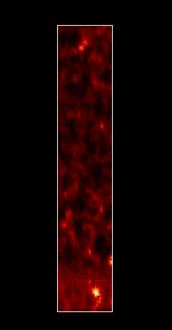
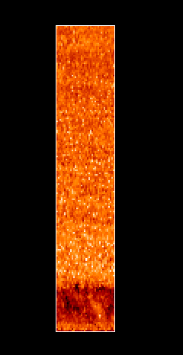
Raster Images
Notes:
Note how you can now compare these side by side

Slide 15
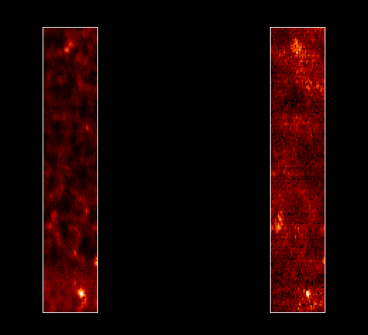
Raster Images

Slide 16
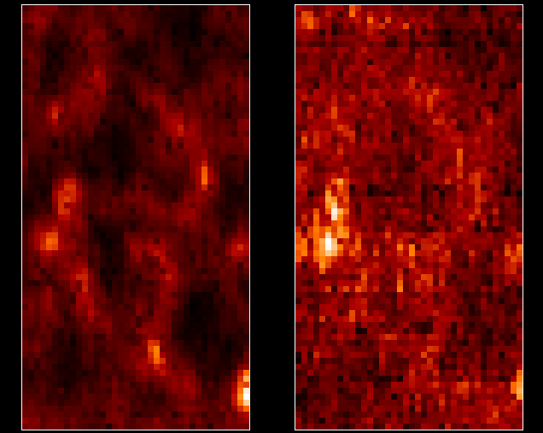
Raster Images

Slide 17
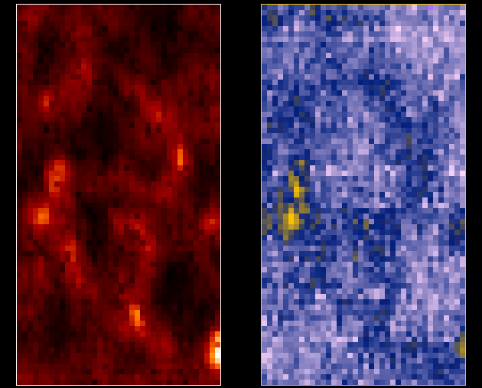
Raster Images

Slide 18
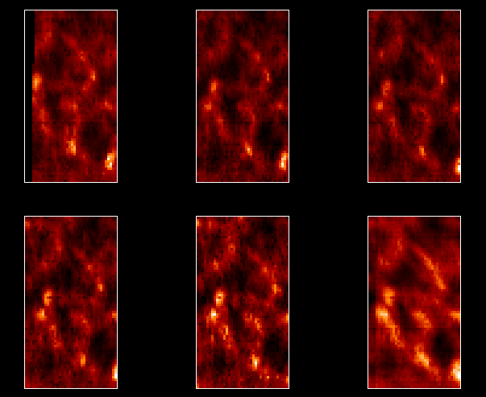
Raster Images

Slide 19
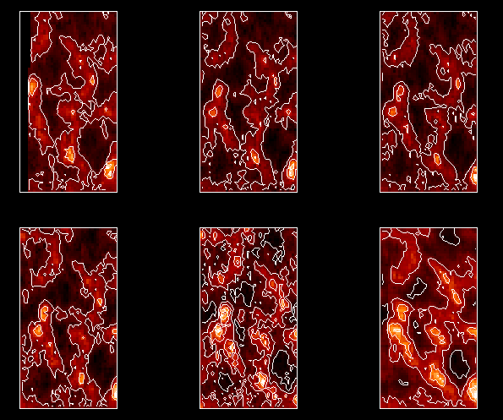
Raster Images

Slide 20
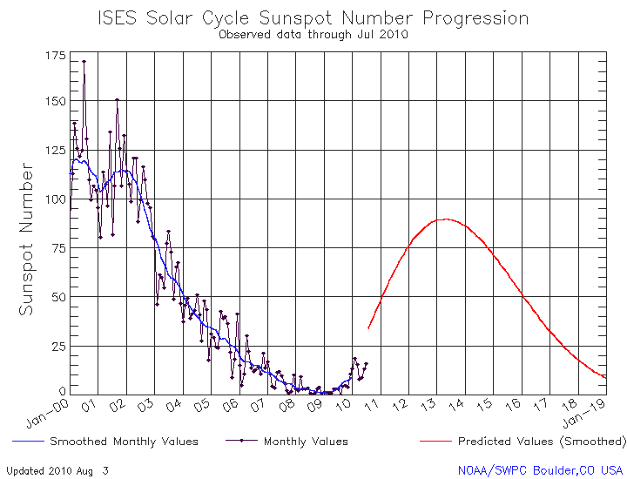
Quiet Sun :(

Slide 21
What I learned
What spectra are
Physics
  Quantum
  Atomic
  Astro
  Plasma
IDL
Data reduction

Slide 22

What I Learned
⇔

Slide 23
Future
Make GUI for program
Continue to analyze data
  Look at short wavelength channel
  Hope for interesting results

Slide 24
Thank You
Jeff Brosius
Doug Rabin
Pat Haas
Adrian Daw
Fred Bruhweiler

